Slide 1
Efficient Compression of 3D Volumes
Professor : Shuang Zhao
I-SURF Fellows : Doona Lee, Kisang Cho
Notes:
Good morning!
Thank you for attending our presentation.
I’m delighted to introduce our research today.
My name is kisang cho, and this is my partner Doona Lee.
The topic of today’s presentation is efficient compression of 3D volumes for rendering and visualization.

Slide 2
Outline
1
3
5
Back-
ground
Overview
Demo
2
4
6
Goal
Progress
Q&A
Notes:
This is our presentation outline.
We will talk about research background, goal, overview, progress
and we will show you the Demo video of our project and finally we will welcome your questions.

Slide 3


Slide 4

Let’s Begin!
Notes:
Let’s begin!

Slide 5
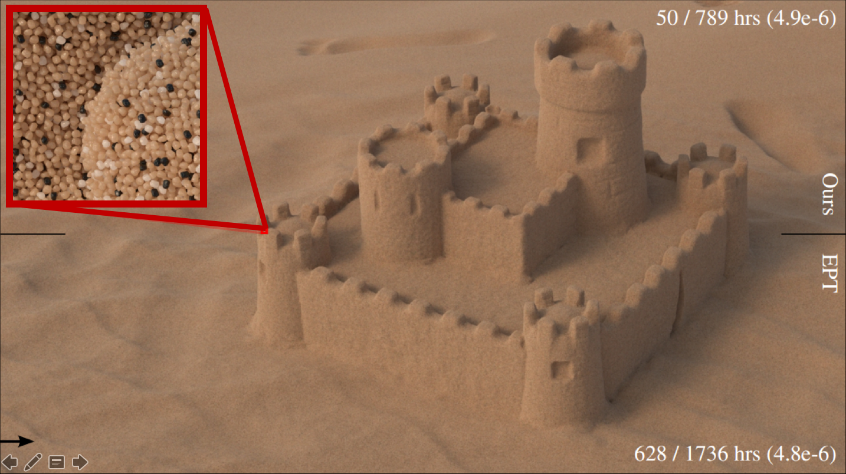
Background
Notes:
High-resolution 3D volumes are widely used to render highly detailed objects. This sand castle represented as a 3D volume, for example, contains details down to individual sand granules (see the red box)

Slide 6
Background
We can
print out
the 3D volume!
Notes:
Also, when we make 3D print item, We usually fill internal material.
So we can use volume file in 3D print to print out the 3D volume item.
As a result, 3D volume have become valuable in the real world.
And it’s starting to be used in more and more areas.

Slide 7
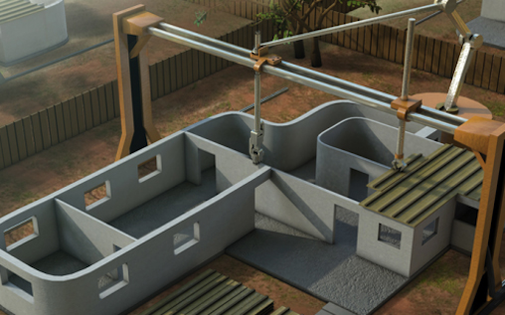
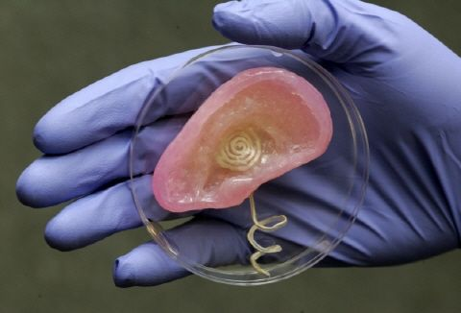
Background
Notes:
Such as in the field of architecture, biotechnology, clothing.
But there are still some problems that need to be resolved.
3D volume require much storage and is expensive to work with.
(click)Let’s bring the red velvet curtain to see a prior example.
그래서 더욱더 3D 볼륨이 많이 사용되게 됬는데,
문제가 있어.

Slide 8
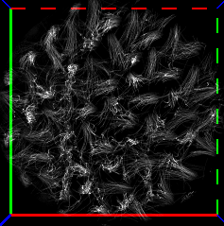
Background
Too Big!
Notes:
(click click)Even storing the curtain’s material requires a capacity of 1,219,587KB.
(click)It’s just too big!
We want to make it smaller.

Slide 9
Goal
develop data compression schemes that can
Sharp decrease in data size
Maintain high efficiency for common volume lookup operations.
Notes:
So the goal of this project is to develop data compression schemes that show a sharp decrease in data sizes and maintain high efficiency for common volume lookup operations.

Slide 10
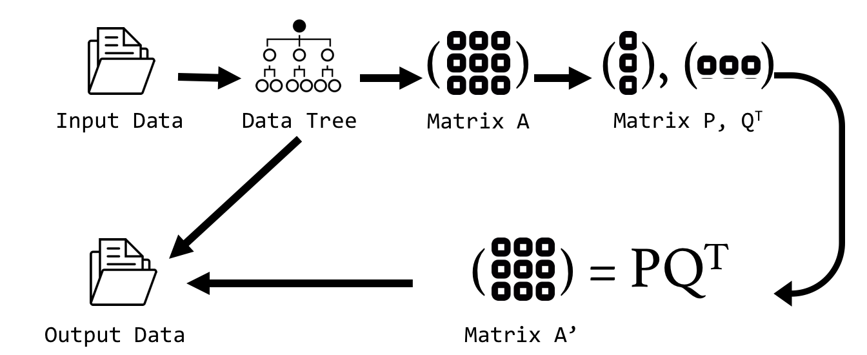
Overview
Notes:
The diagram above shows the basic project overview.
We can divide our research into 4 steps,
The first to third step is to compress the 3D volume file.

Slide 11
Overview
1
Notes:
first step is making a tree.

Slide 12
Overview
2
Notes:
Second step is making a matrix.

Slide 13
Overview
3
Notes:
Third is compression by matrix factorization

Slide 14
Overview
4
Notes:
and the final step is to decompress the result of the first step.
Then she will talk about more detail

Slide 15



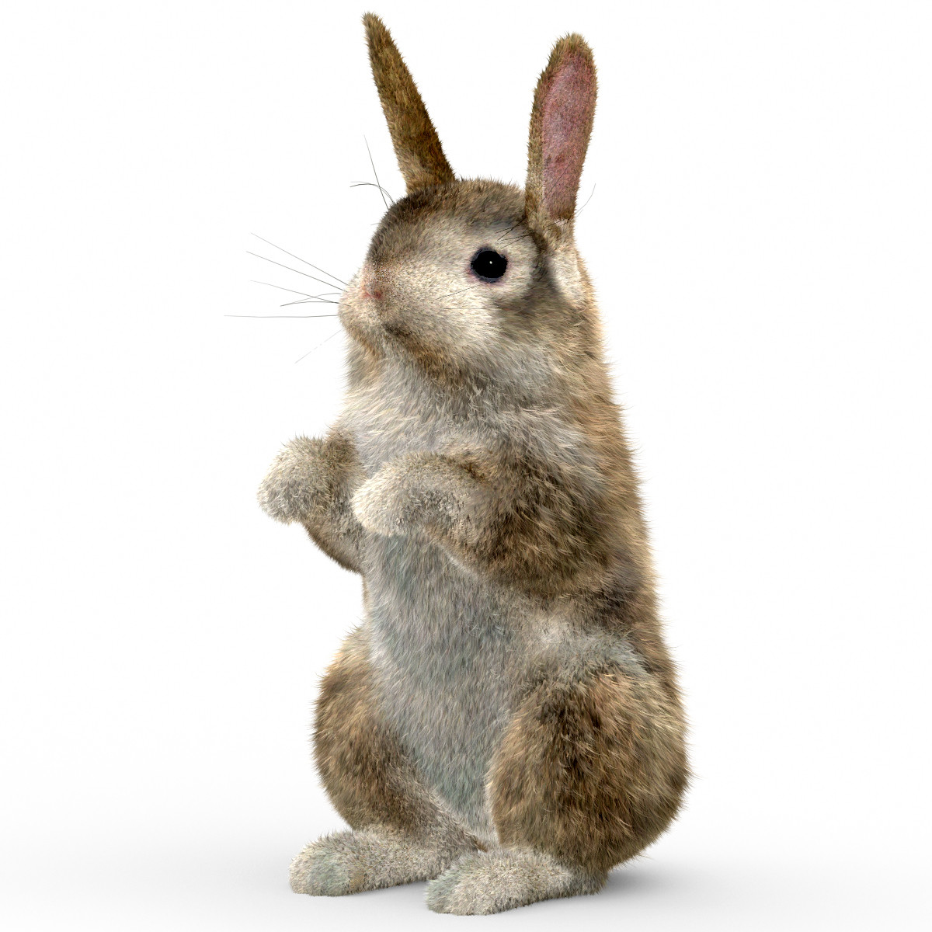
Progress
Notes:
Let’s talk about this in more detail.
Suppose there is a cute rabbit model.
We want to store it in a computer.
이제 좀 더 자세한 이야가를 해보자
귀여운 토끼 모델을 컴퓨터에 저장하고자 한다.

Slide 16

Progress
Notes:
How can we do that?
This is one of the method.
Put the rabbit in a box.
And remove the portion of the box except the model.

Slide 17
Step 1
Notes:
And we tried to compress the model.
This is first stage of compression, we will store this rabbit in a tree.
(click)Put the rabbit in a box.
And split the box like this.(click, click, click)

Slide 18
Step 1

Slide 19
Step 1

Slide 20
Step 1

Slide 21
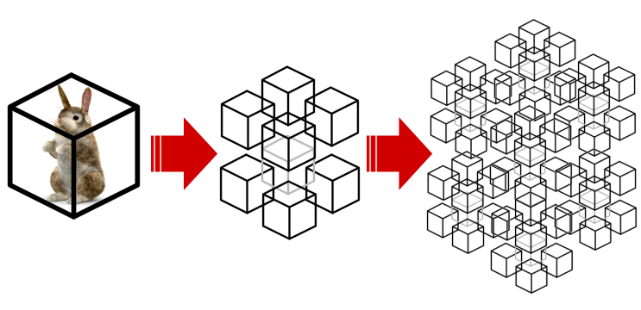
Step 1
Notes:
(click)Now we got eight sub-volumes including the parts of the rabbit model.
Recursively split sub-volumes, then we can make a tree.
In this work, we must have a stop condition.
쪼개는 작업을 리컬시브하게 반복하여 트리를 만든다.
19쪽 전에 sub-volume split recon~ we got tree

Slide 22

Step 1
Condition
1.
The sub-volume is smaller than minimum size
2.
the model within the sub-volume is too small
Notes:
There are two essential conditions that must be confirmed.
First, check if the sub-volume is smaller than the minimum size
Second condition is if the model within the sub-volume is too small.
This condition should be applied recursively to all sub-volumes.
우리에겐 필수적으로 확인해야 할 두 가지 조건이 있다.
자 이제 모든 조각들에 대해 이 조건을 적용할 것이다.
그냥 끝나는 조건이라는 것만 설명할 것.

Slide 23
Step 1
Apply the flowchart
to all leaf nodes
Yes
Is it leaf node Check two conditions
End
No
Split again
Notes:
On the basis of the flow chart.
Check is it leaf node? then check the two conditions we saw before.
If it satisfies the conditions, stop.
But if it doesn’t, continue with the work until the end.
Through these operations, we can obtain the tree which is stored input data.
모든 조각들은 이 순서도에 따라 처리한다.
조각들이 리프 노드인지 확인하고
앞서 언급한 두 개의 조건을 확인한다.
조건이 맞다면 조각을 나누는 것을 멈추고,
조건이 맞지 않는다면 해당 조각을 다시 나누어 나눈 조각으로 이 과정을 반복한다.

Slide 24
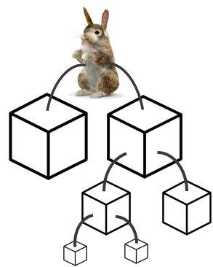
Step 1
I’m
A original box
Notes:
Like this.
(click)Now we have a tree.

Slide 25
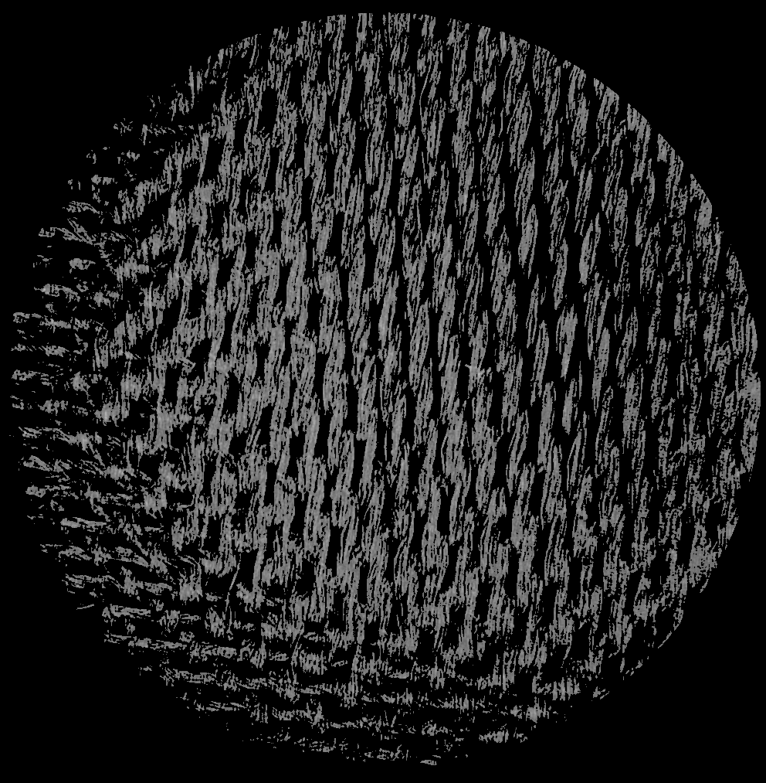
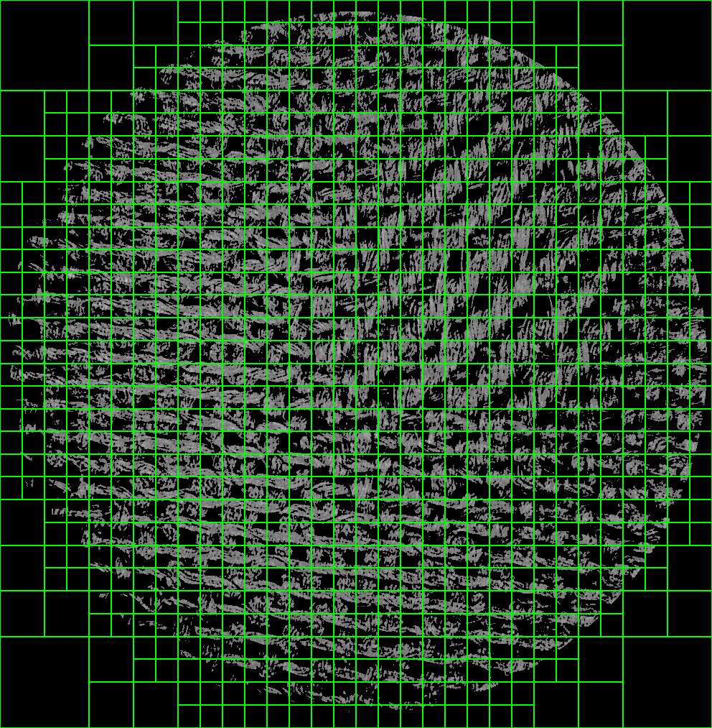
Step 1
Notes:
This is the part of our result from our project.
Those images are slice of a 3D volume.
The left side shows the original file and the right side shows the leaf nodes.
트리 스텝 원 끝에 넣을 것

Slide 26
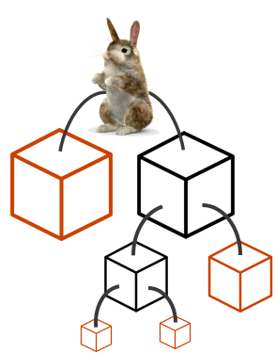
Step 2
I’m
A original box
Notes:
(click)And these are the leaf nodes of the tree.

Slide 27
Step 2
These are
leaf nodes
Notes:
Remove all the things except the leaf nodes.
We want to represent the leaf nodes as a matrix.
Bringing the leaf node to the top.
스텝 투

Slide 28
Step 2
B
I
I
I
I
I
I
G
S
S
M
I
D
U
A
Matrix
Notes:
Every node will convert to a single vertical line of the matrix.
However, since the sizes of the leaf nodes are different, the length of each column has to be different.

Slide 29
Step 2
B
I
I
I
I
I
I
G
0
0
0
0
0
0
0
0
0
0
0
0
0
0
S
S
M
I
D
U
A
0
0
0
0
Matrix
Notes:
So we put zeroes in the empty spaces to complete the matrix and to avoid the blank spaces.

Slide 30
Step 2
B
I
I
I
I
I
I
G
0
0
0
0
0
0
0
0
0
0
0
0
0
0
S
S
M
I
D
U
A
0
0
0
0
Notes:
Now matrix A has been completed.
이제 우리는 행렬A를 완성했다.

Slide 31
Step 3
B
I
I
I
I
I
I
G
0
0
0
0
0
0
0
0
0
0
0
0
0
0
S
S
M
I
D
U
A
0
0
0
0
is LARGE (in GBs)
Notes:
Let’s move to step 3.
This is the most important part of our project.
But it’s simple.
Matrix A is toooo large. Sometimes it takes several dozens of gigabytes.

Slide 32
Step 3
Matrix Factorization
B
I
I
I
I
I
I
G
0
0
0
0
0
0
0
0
0
0
0
0
0
0
S
S
M
I
D
U
A
≈
0
0
0
0
P *
Q^{T}
P and Q are much smaller
Notes:
We can express the matrix A by two small matrices P and Q by using Matrix Factorization.
P and Q are much smaller than the matrix A,
So they can be stored more efficiently.
In addition, even in a compressed state, we can access a point of the model by using the matrix operation.
This is much faster than traditional compression methods which have to be decompressed every time you want to reach a certain point.
스텝 삼의 시작
메트릭스 A가 크다는 것을 다시 상기시켜 줄 것.
Combine the P&Q is much smaller than A
Motivate first

Slide 33
Step 3
n
r
n
m
r
m
A
≈
P
Q^{T}
Condition : r << m, n
We can express a matrix A
by two small matrices P and Q
Notes:
There is an R value that determines the size of matrices P and Q.
R is much smaller than m and n, but it can control P and Q by change value .
여기서 P와 Q의 크기를 결정하는 값 R이 있다.
R은 m, n보다 훨씬 작지만, 그 크기는 클 수도 있고 작을 수도 있다.
R1, r2로 나눠서 할 것
뒤에꺼는 한장 더 나눠서 할 것.
큰 R을 왼쪽으로 할 것
인풋과 아웃풋이 뭔지 더 설명해야 함.

Slide 34
Step 3
n
r1
n
r2
r1
n
m
m
m
r2
A
≈
P
≈
P
Q^{T}
Q^{T}
Condition : r2 < r1 << m, n
Large R | High accuracy Low compression
Low R | Low accuracy High compression
Notes:
If R is big, we got high accuracy but low compression.
If R is small, we got high compression but low accuracy.
We tried to find a point which can maintain proper accuracy and compression efficiency.
R값이 크다면, 정확도가 높아지지만 압축률이 낮아지고
R값이 작다면, 정확도가 낮지만 압축률이 높아진다.
우리는 적정한 정확도를 유지하면서 압축효율을 높일 수 있는 R값을 찾기 위해 노력했다.

Slide 35
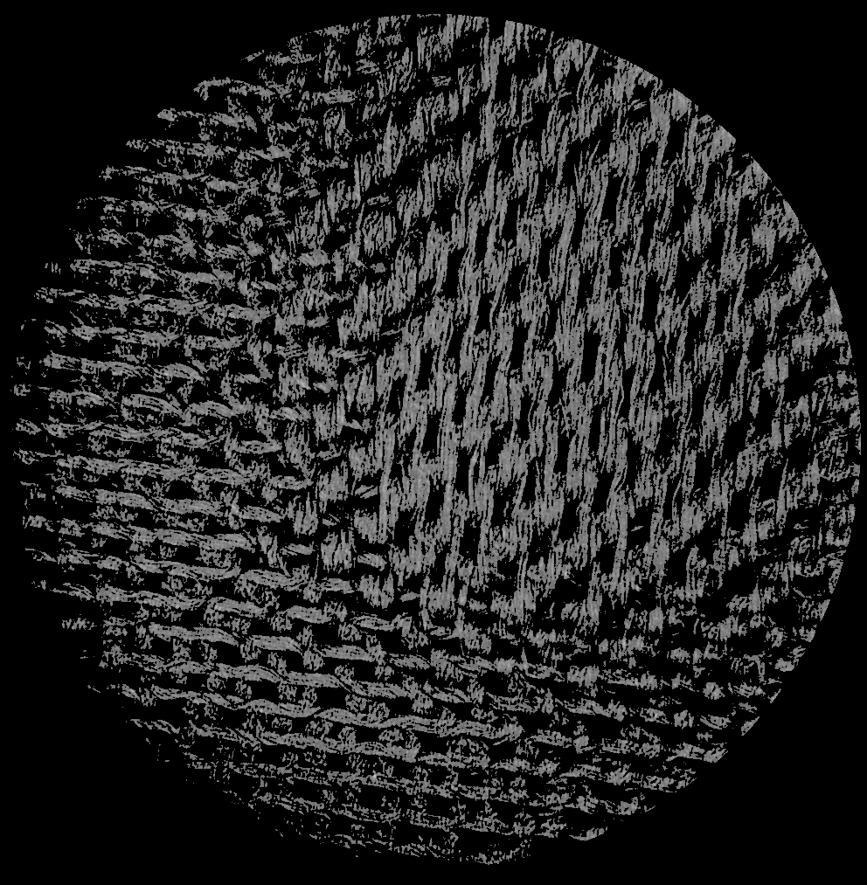

Step 3
Original File
R = 400
Notes:
This is part of our result.
Let’s see the change of reconstructed file according to R value.
The left one is the original file and right one is the reconstructed file when r is 400.
They look almost identical.
R값의 변화에 따라 복원되는 파일이 어떻게 변화하는지 살펴보자
왼쪽은 원본 파일, 오른쪽은 R값을 400으로 설정하였을 때 복원된 파일이다.
거의 비슷해 보이죠?
바뀌는거 오른쪽으로 바꿀 것.

Slide 36

Step 3
Original File
R = 200
Notes:
Change R value to 200 and they are almost the same.
자 이제 R값을 200으로 바꿨다. 그래도 거의 비슷하네요

Slide 37

Step 3
Original File
R = 100
Notes:
Change to 100.
Can you see any difference?
100으로 바꾸면 차이가 느껴지나요?

Slide 38
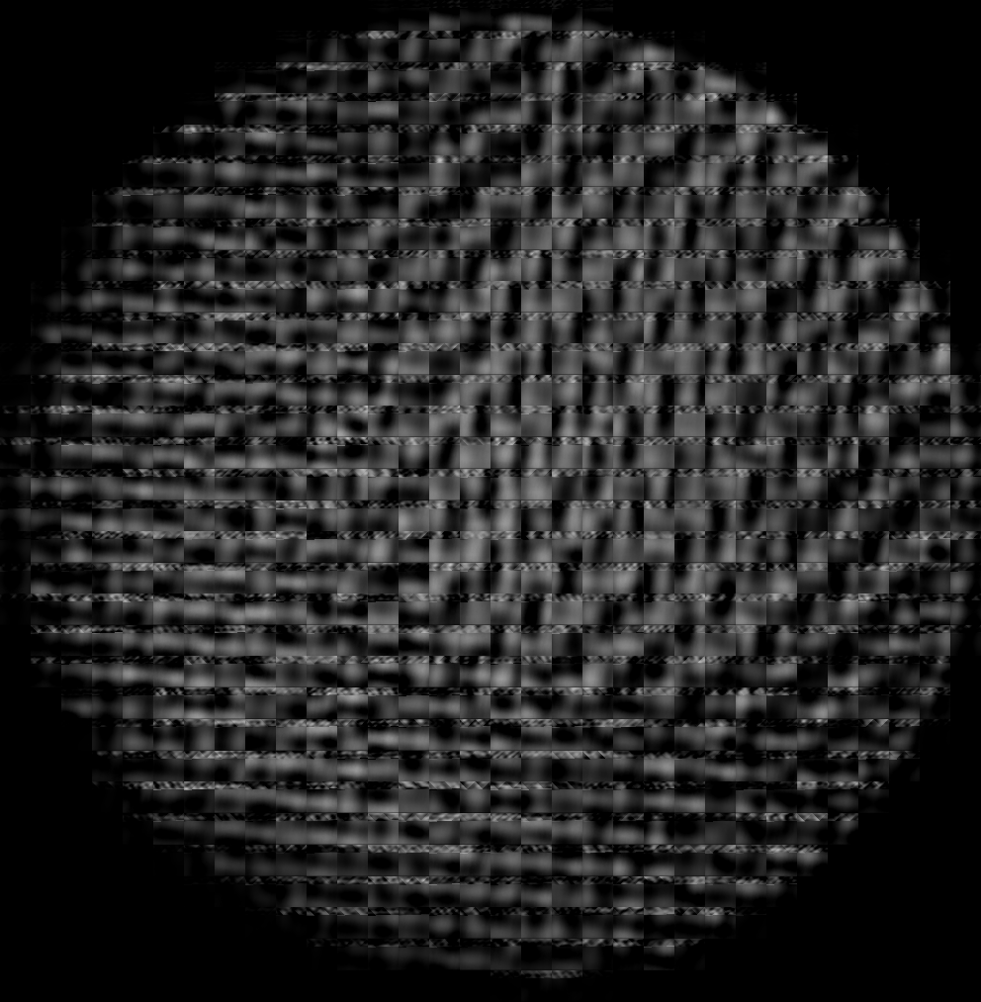
Step 3
Original File
R = 20
Notes:
To show a significant difference, reduce the R value to 20.
Now you can feel a big difference.
Thus, the R value has a large influence on the compression and reconstruction.
큰 차이를 보여주기 위해 20까지 줄여봤다.
이처럼 R값이 압축과 복원에 큰 영향을 미치는 것을 볼 수 있었다.

Slide 39
Step 3
Notes:
이 그래프는 r값 변화에 따른 용량 변화 그래프 입니다.
This is graph for changing capacity about r value changing.
We can cofirm changing of capacity for r value changing.
Also we knew that if r value is 200 or 100, we get similar picture but capacity is much smaller.
우리는 r 값을 변경함에 따라 용량이 변하는걸 확인할 수 있었습니다.
또한 R값이 200 혹은 100일 경우에도 비슷한 화질을 얻지만 용량은 현저히
줄었다는 것도 알수 있습니다.

Slide 40
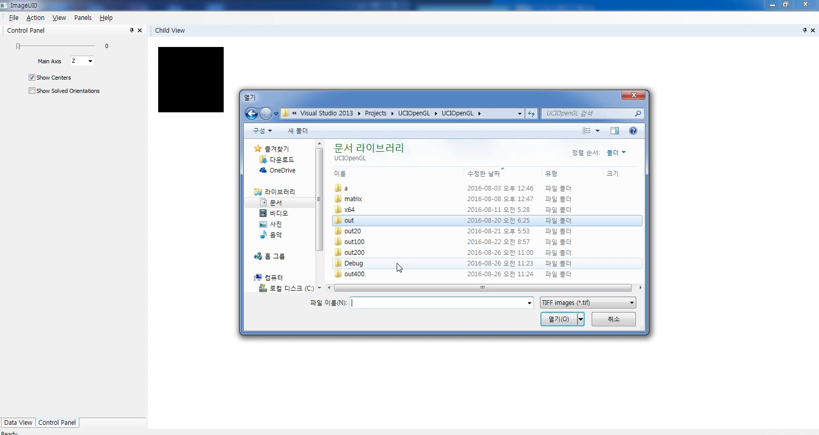
Step 4 (Demo)
+
Output Data
Notes:
Those are image files that saved dates are compose of matrix made by P and qt and tree which is divided Z axis. P and qt matrix which has 400 r are used.
(사진들넣기)These pictures produce each image when you put these into ImageUI tool.
(저장)And it is making volume files by using images you get.
Afterwards, you can see volume files are as below if you open volume files with CT_TestUI application.

Slide 41
Step 4
+
Output Data
Benefit in this technique
Easy access A[i, j] = P[i, :] * (Q[j, :])^{T}
Only need to store P and Q in practice
Notes:
We got some benefits in this technique.
First, We can access only a portion of the volume data.
Second, we only need to store P and Q. those are much smaller than original file.
We developed a technique which is data efficient compression schemes and maintain high efficiency for common volume lookup operations.

Slide 42

Thank You
Questions?
Notes:
Before I wrap up, I would be happy to answer any questions.
Thank you for listening. Thank you!

